Slide 1




Maximizing Retail Sales: A Data-Driven Approach
The retail industry is fiercely competitive. To succeed, retailers must use data analytics to churn insights that will help them optimize sales strategies and increase customer loyalty.
by Aditya Swarnakar

Slide 2

Sales Analysis
1
Top-Selling Products
2
Sales Trends
Identify the products with the highest sales volume and revenue
Track sales patterns over time to identify seasonal trends or fluctuations
3
Most Profitable Products
Identify product lines that drive profitability and prioritize them for marketing and inventory management

Slide 3

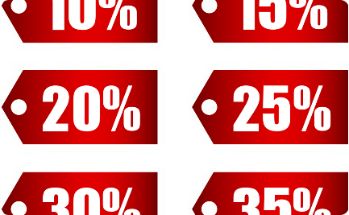

Product Analysis
Product Performance
Underperforming Products
Product Line Performance
Evaluate sales, quantity in stock, and profitability to make data-driven decisions
Identify underperforming products and make necessary adjustments
Analyze the performance of product lines to understand the categories that drive sales and profitability

Slide 4
Customer Analysis
1
Segmentation
Segment customers based on their purchasing behavior, demographics, or geographic location to create targeted marketing campaigns
2
High-Value Customers
Identify high-value customers and develop strategies to retain and upsell them
3
Preferences
Analyze customer preferences to personalize marketing campaigns and improve customer experiences

Slide 5
Demographic Analysis
Understanding Customer Demographics
Targeted Marketing Campaigns
Evaluate Marketing Effectiveness
Identify target demographics for specific products or marketing campaigns
Evaluate the effectiveness of marketing efforts in reaching and engaging different demographic groups
Understand the distribution of customers across different demographics like age, gender, and location

Slide 6
Inventory Analysis
Optimize Inventory Levels
Identify Slow-Moving or Overstocked Products
Analyze product demand and sales patterns to optimize inventory levels
Take appropriate actions such as offering promotions or adjusting procurement for slow-moving or overstocked products

Slide 7
Marketing Analysis
Evaluate Campaigns
Allocate Resources
Tailored Messages
Identify the most successful marketing channels and allocate resources accordingly
Use customer segmentation data to tailor marketing messages and offers to specific customer groups
Evaluate the effectiveness of marketing campaigns by analyzing sales uplift and customer response

Slide 8

Summary
By analyzing data on sales, customers, demographics, inventory, and marketing, retailers can gain insights into their performance and optimize their strategies accordingly. This leads to increased sales, profitability, and customer satisfaction.

